Slide 1
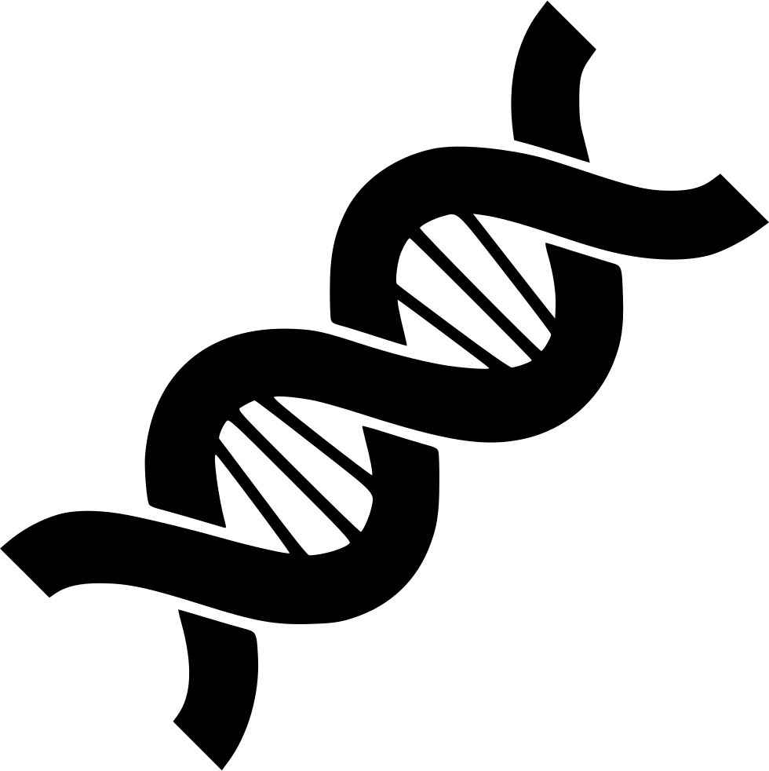
Genetics
Chapter 6

Slide 2
6.5 Traits and Probability
After this section you will be able to……
Predict possible genotypes resulting from a monohybrid cross and dihybrid cross.
Perform a testcross in order to determine the genotype of the parent in a specific genetic cross.
Calculate the probability of a particular event involving genetics.

Slide 3

TEKS
B.6F - predict possible outcomes of various genetic combinations such as monohybrid crosses, dihybrid crosses and non-Mendelian inheritance

Slide 4
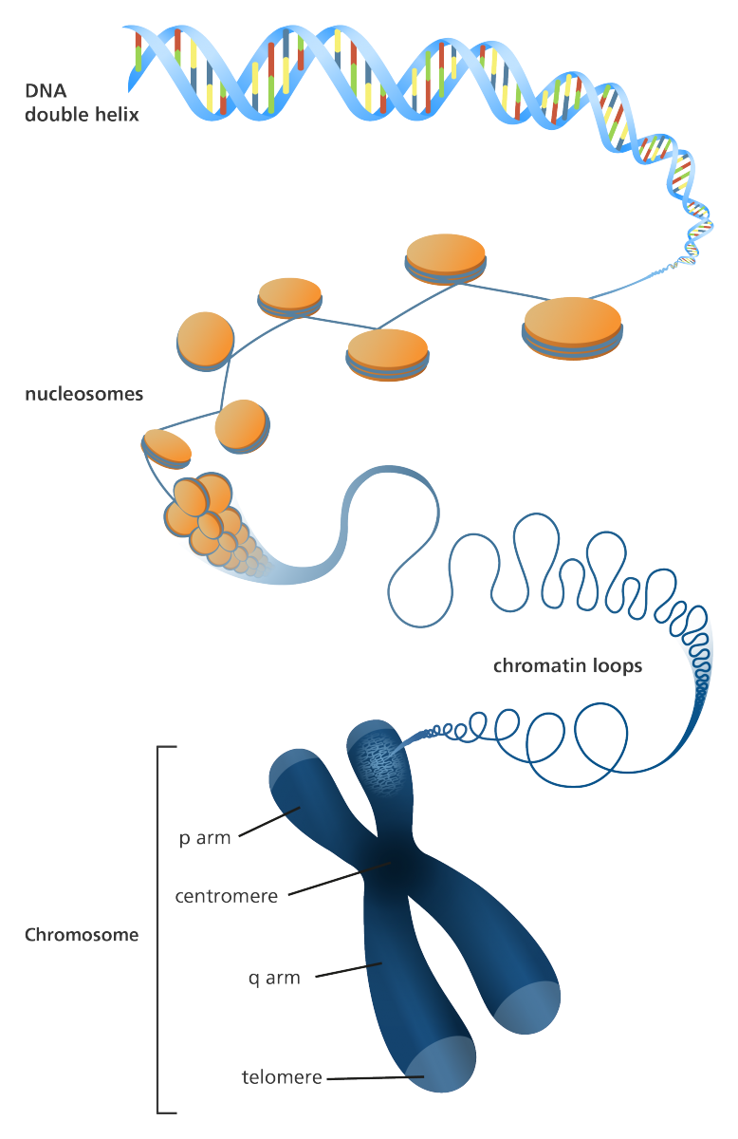
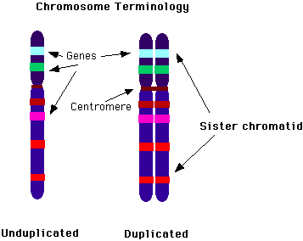
Recall….Chromosomes

Slide 5
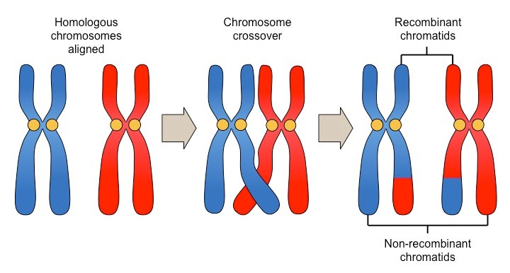
Crossing over, or recombination occurs...

Slide 6
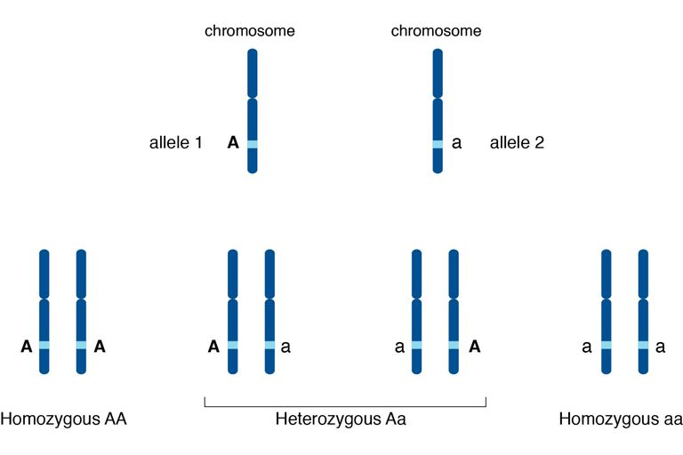
Recall….Alleles

Slide 7
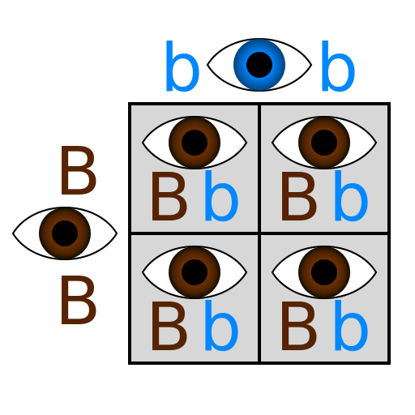
Punnett Squares
Punnett Squares are used to determine the possible genotypes of a cross between two parents.
A monohybrid cross examines inheritance of only one trait.
A dihybrid cross examines inheritance of two traits.

Slide 8
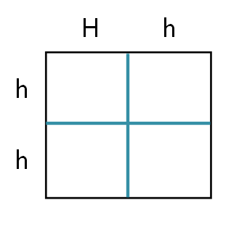
Monohybrid Cross
Simple diagram used to predict expected result of a genetic cross
Genetic Cross
Hh x hh
Punnett Squares consider all possible combination of gametes for that particular cross
Hh
hh
Hh
hh

Slide 9
Testcross
A testcross can be performed to determine the genotype of a particular organism. Note, the unknown genotype must be either homozygous dominant or homozygous recessive.
If you cross the unknown organism with a homozygous recessive organism, the offspring will either express only the dominant phenotype or half dominant and half recessive phenotype.

Slide 10
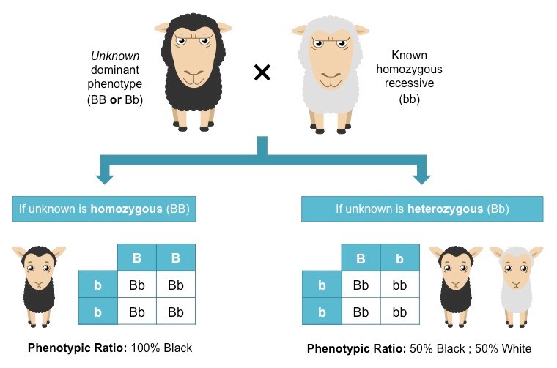

Slide 11
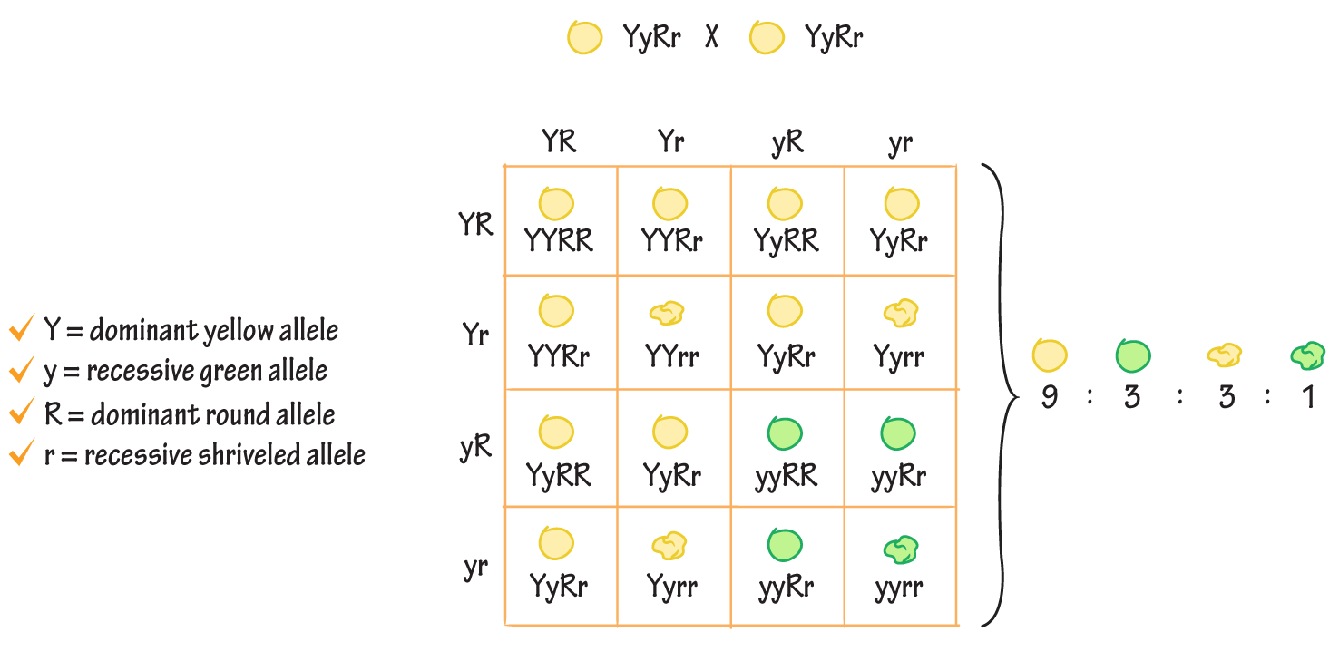
Dihybrid Cross
Remember, the dihybrid cross involves two traits.
This can lead to a total of 16 different genotypes and 4 different phenotypes.

Slide 12
A brown rat with red eyes (BBRr) is crossed with a white rat with white eyes (bbrr). What is the percent chance that they will have an offspring with the genotype Bbrr?

Slide 13
7.2 Complex Patterns of Inheritance
After this section you will be able to……
Describe incomplete dominance and codominance.
Explain the difference between polygenic traits and epistasis.
(Added) Describe sex-linked traits

Slide 14
TEKS
B.6F - predict possible outcomes of various genetic combinations such as monohybrid crosses, dihybrid crosses and non-Mendelian inheritance

Slide 15
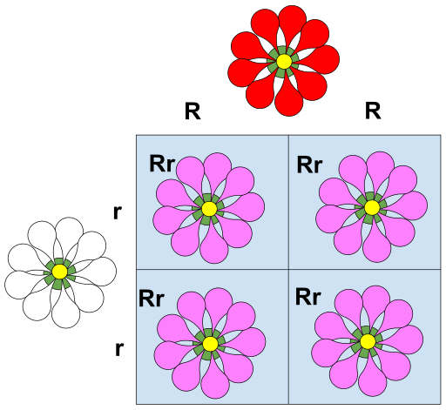
Incomplete Dominance
In Incomplete Dominance both alleles present fight for control of being the dominant allele. When this occurs, the heterozygous phenotype is somewhere in between the two homozygous phenotypes.
Note: incomplete dominance does not show both phenotypes, but a blend of the two.

Slide 16
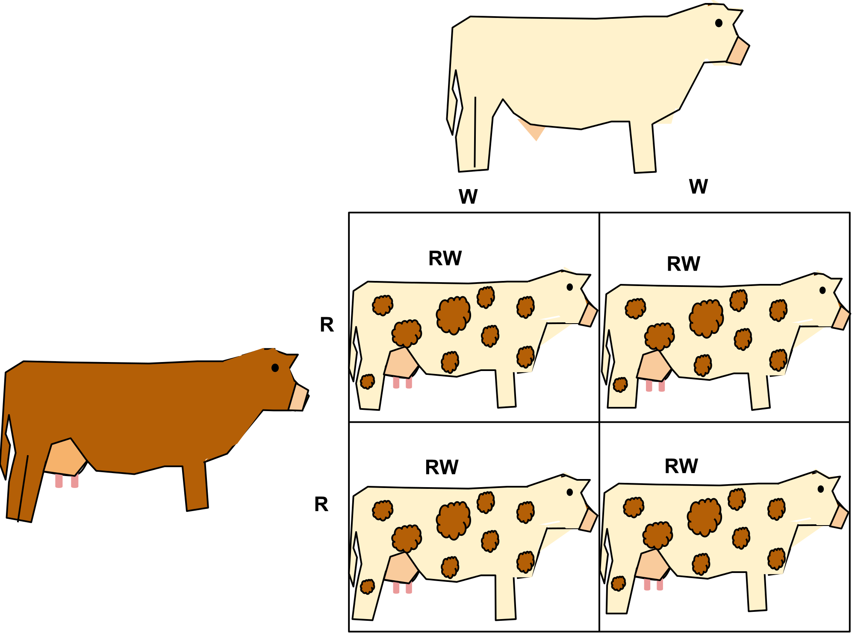
Codominance
In Codominance both alleles are neither dominant or recessive. This means that in a heterozygous phenotype, both alleles are present and expressed completely.
Note: codominance does show both phenotypes, not a blend of the two.

Slide 17
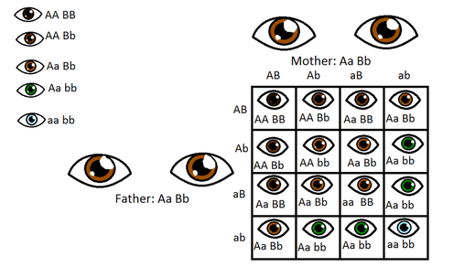
Polygenic Traits
If a trait is controlled by two or more genes well call them polygenic. Two examples are eye color and skin color.

Slide 18
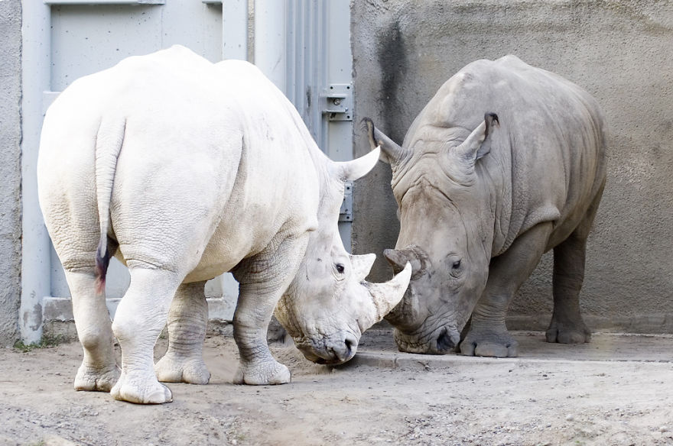
Epistasis
Epistasis is when one gene can affect all other genes and prevent them from being expressed. A common example used for epistasis is albinism.

Slide 19
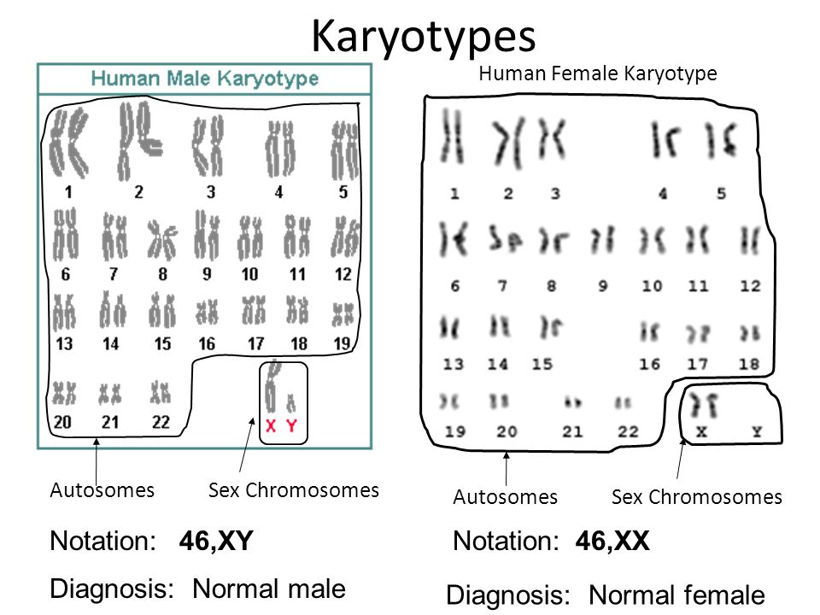
Sex-Linked
What can you tell me about the difference in chromosomes in male and females?
How does the X chromosome compare to the Y chromosome?

Slide 20
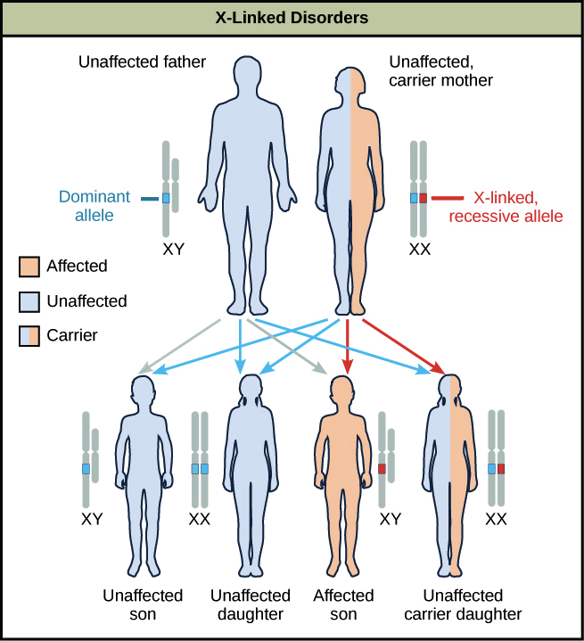
Sex-Linked
Sex-linked disorders exist because of the lack of genes on the Y chromosome.
Recall that heterozygous genotypes express the dominant trait. But what happens if there is only one allele present?

Slide 21
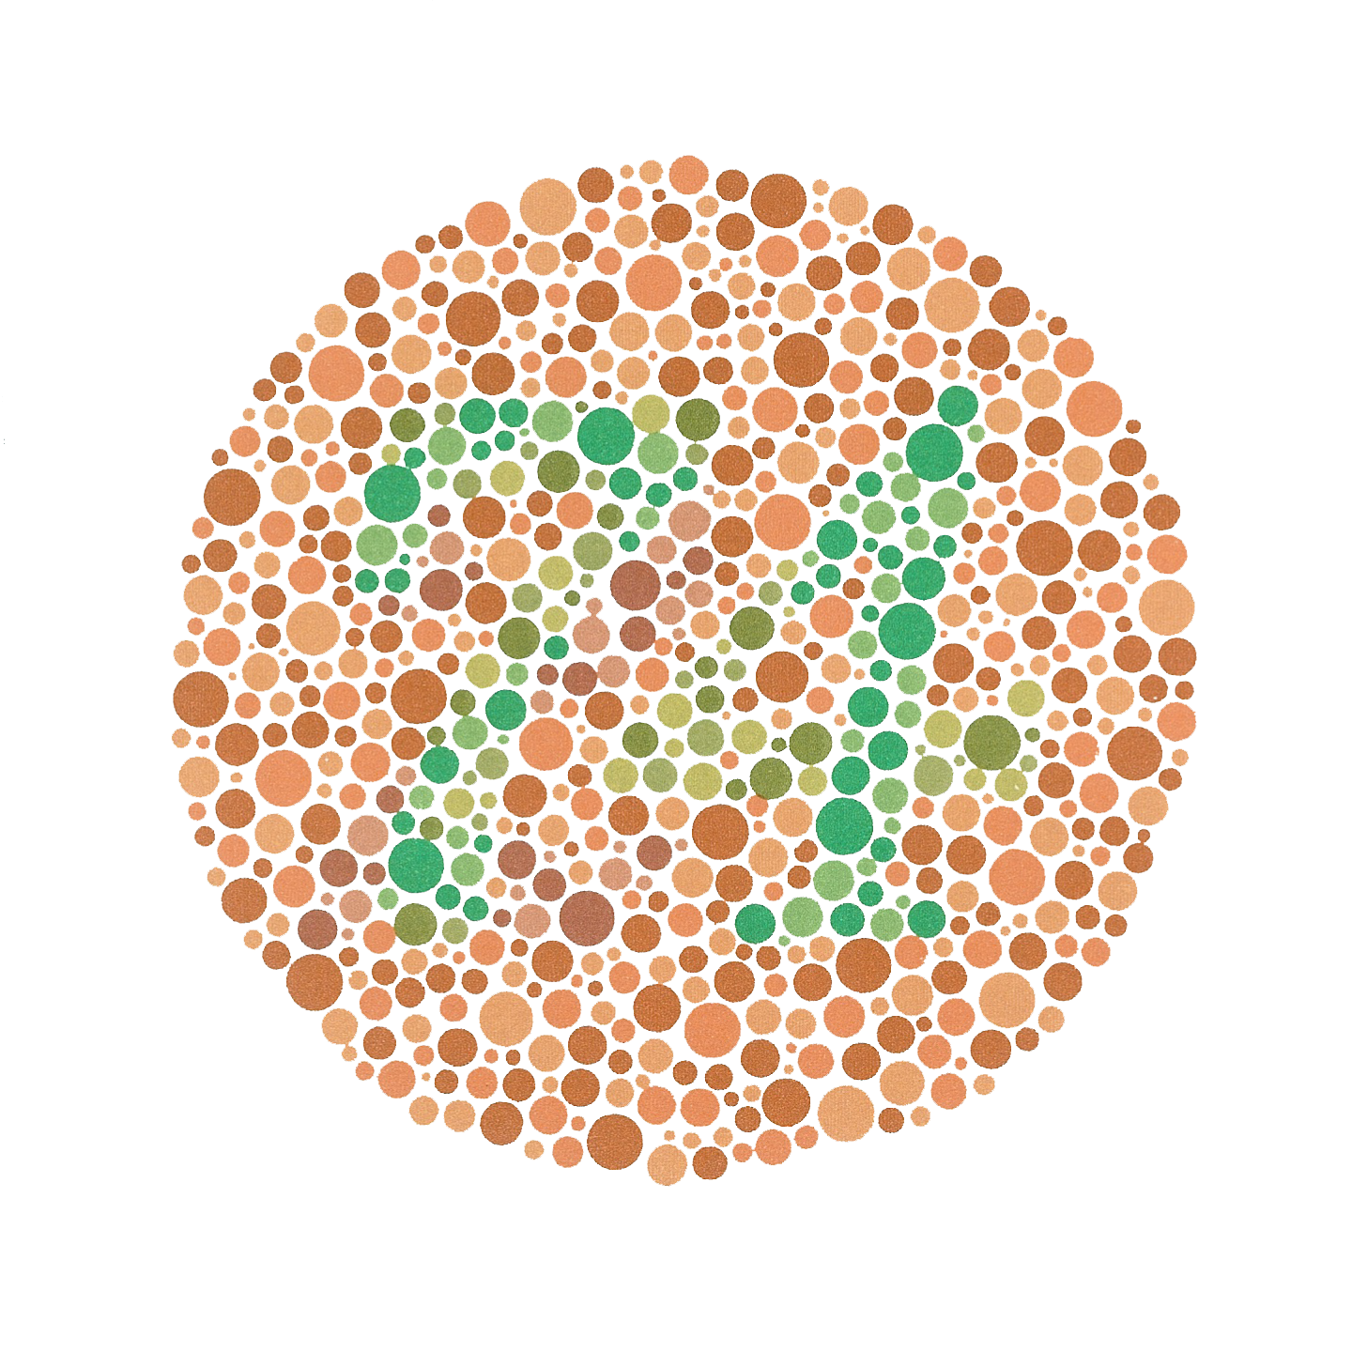
Sex-Linked
Sex-linked disorders often affect males since they will express the trait if they have the recessive gene on their X chromosome. Females have a chance to inherit another X chromosome that dominates the recessive trait.
A female carrier is a heterozygous genotype that “carries” the recessive trait that is not present in the Y chromosome.

Slide 22
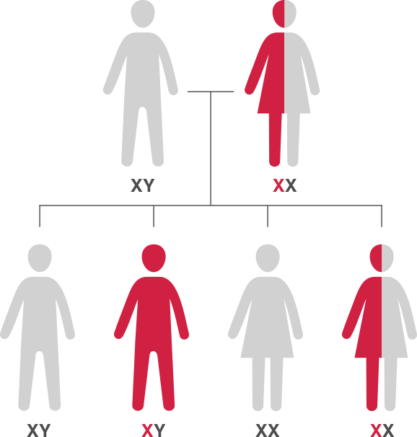
Sex-Linked
Hemophilia is a common example of an X-linked recessive trait. If a female is a carrier and a male does not have hemophilia, there is as 50% chance that a male offspring will have hemophilia and a 50% chance that a female offspring will be a carrier.

